Slide 1
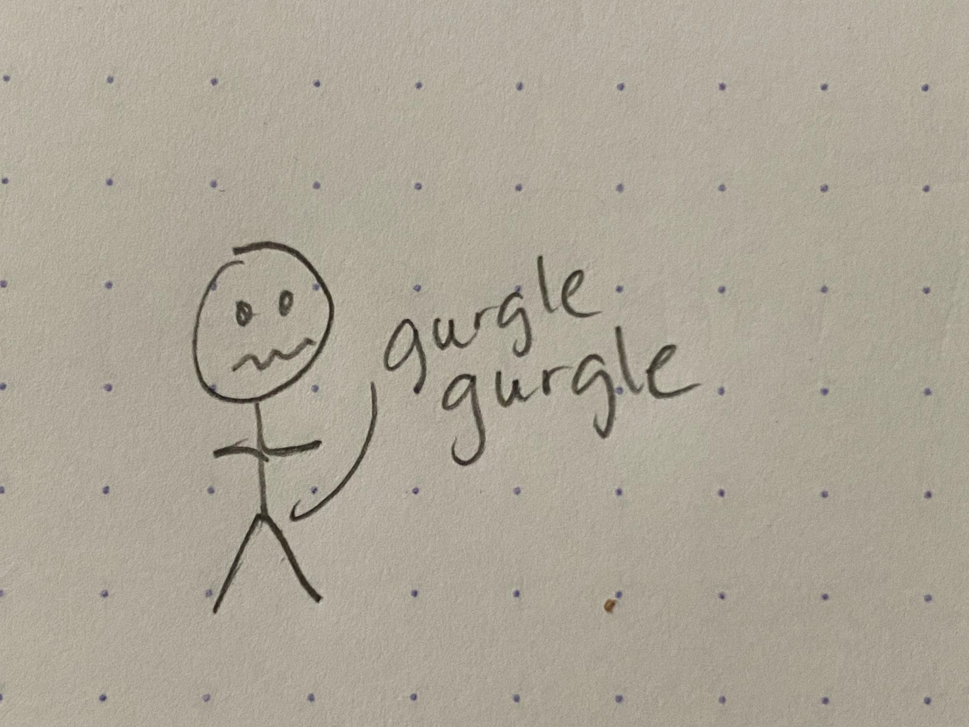
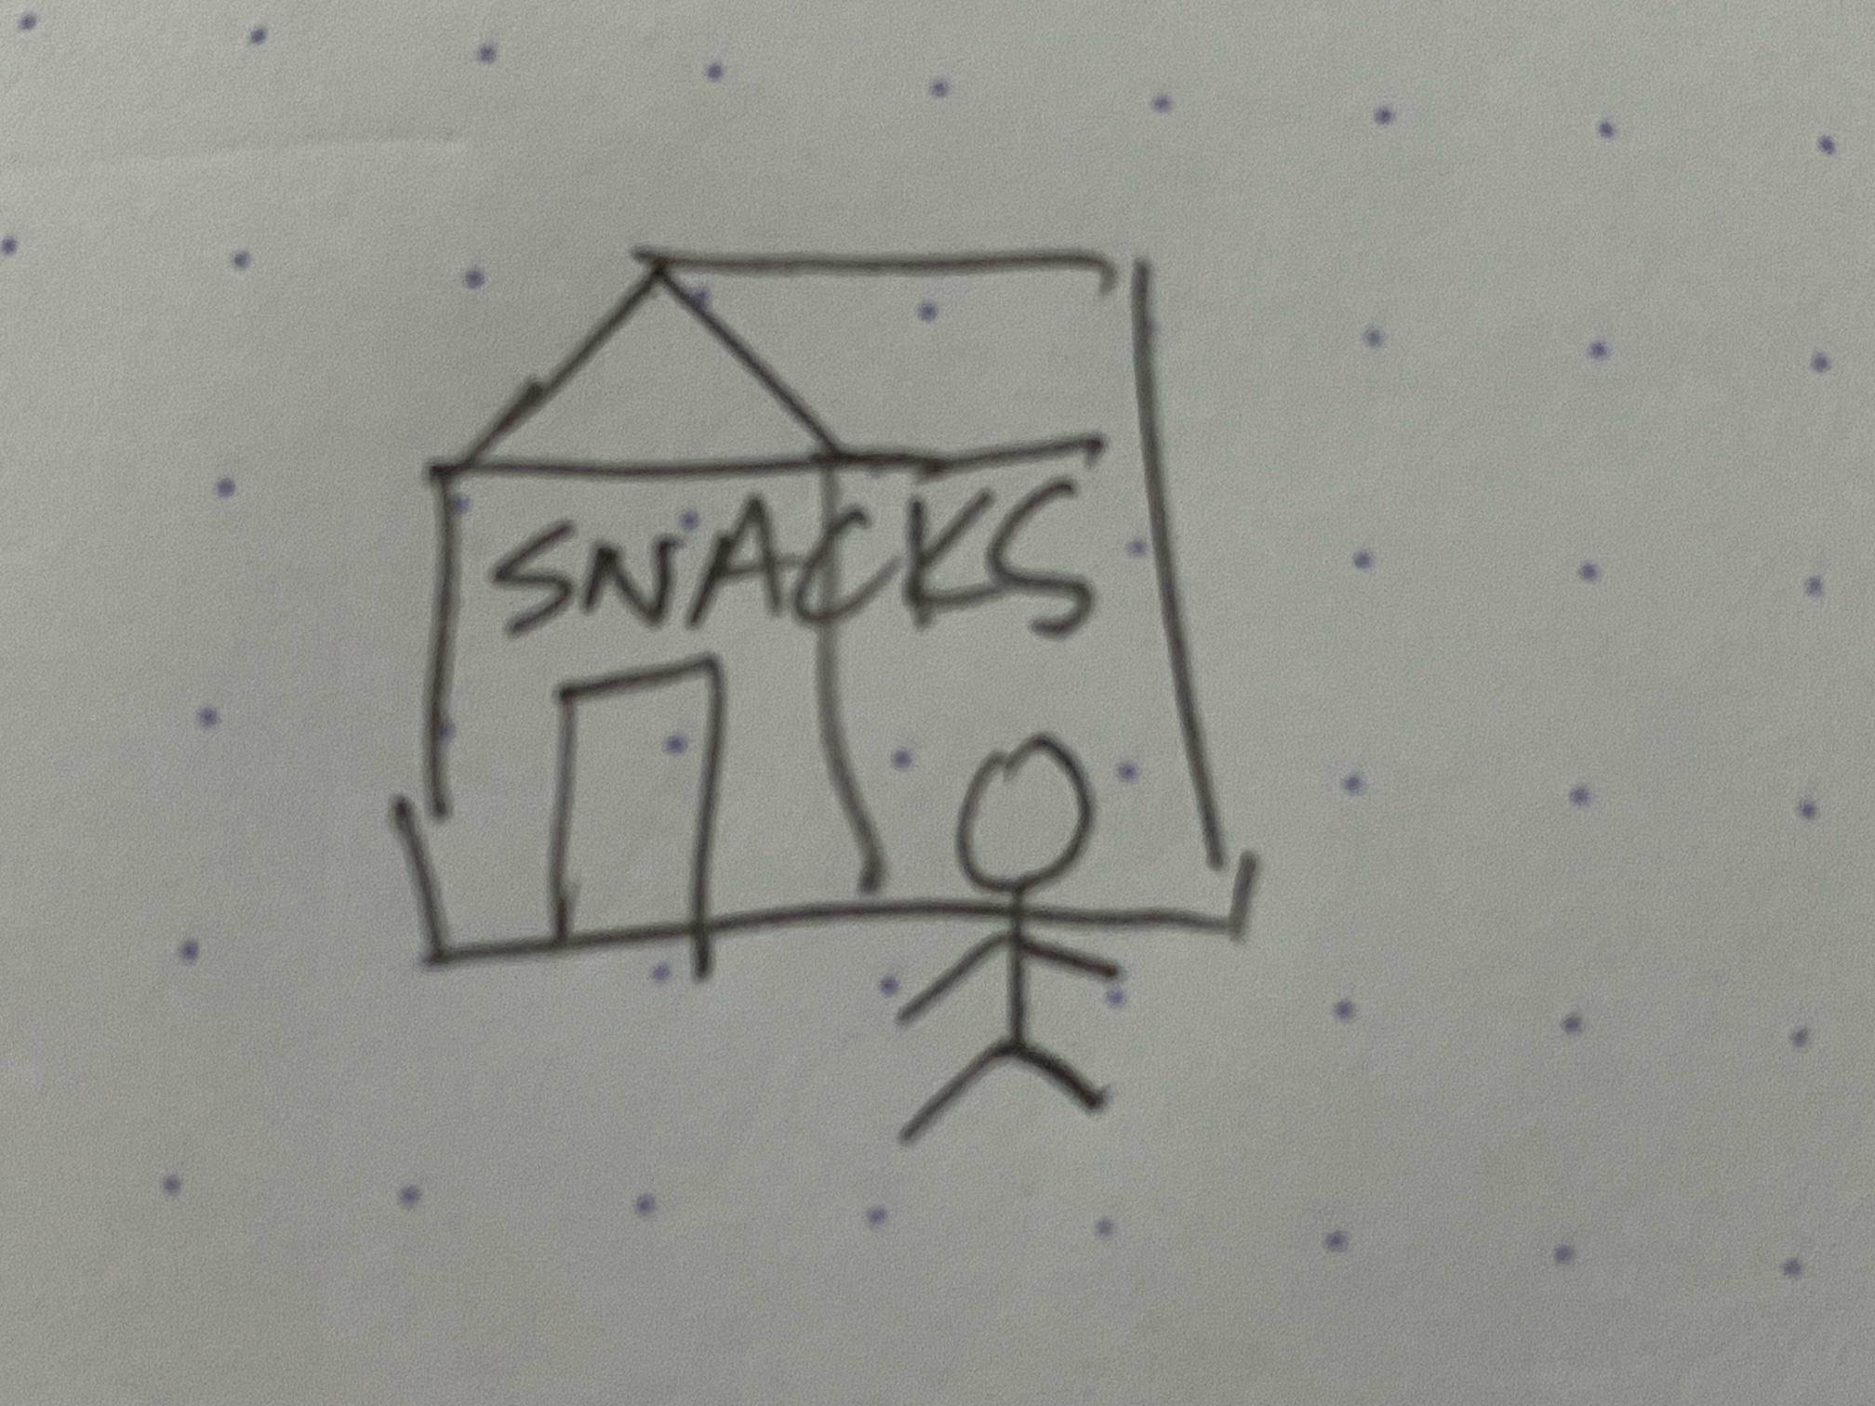
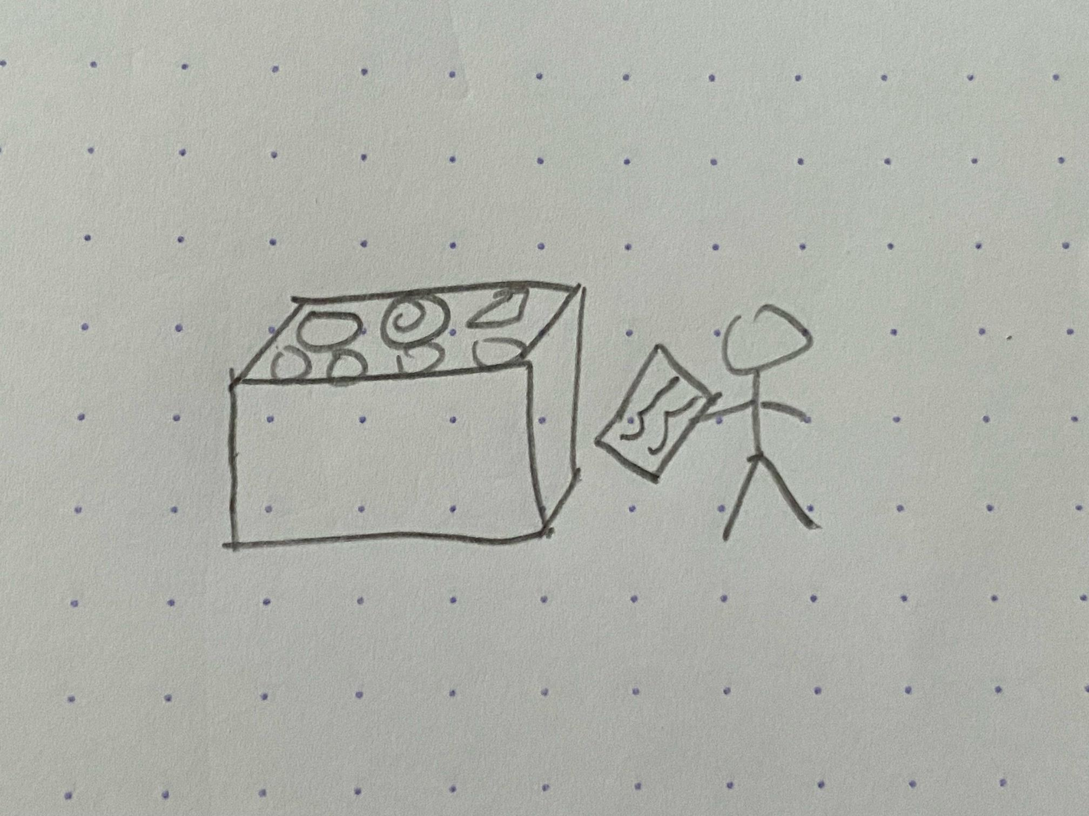
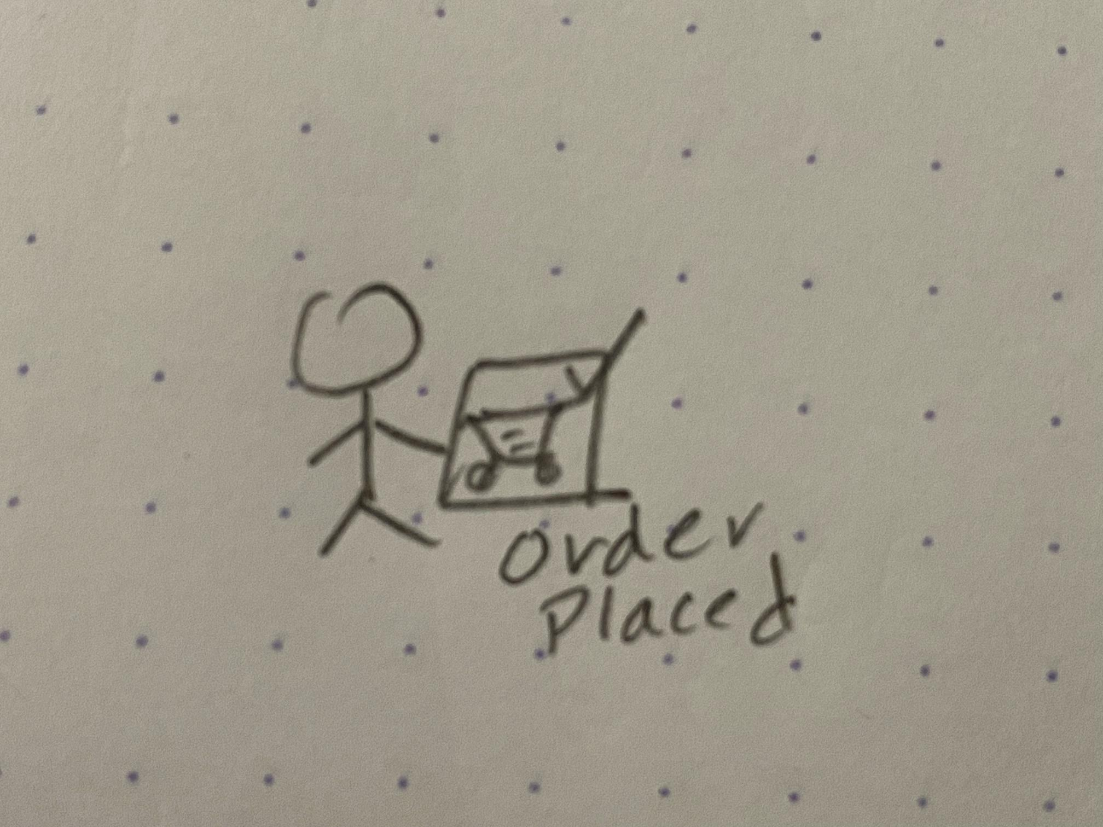
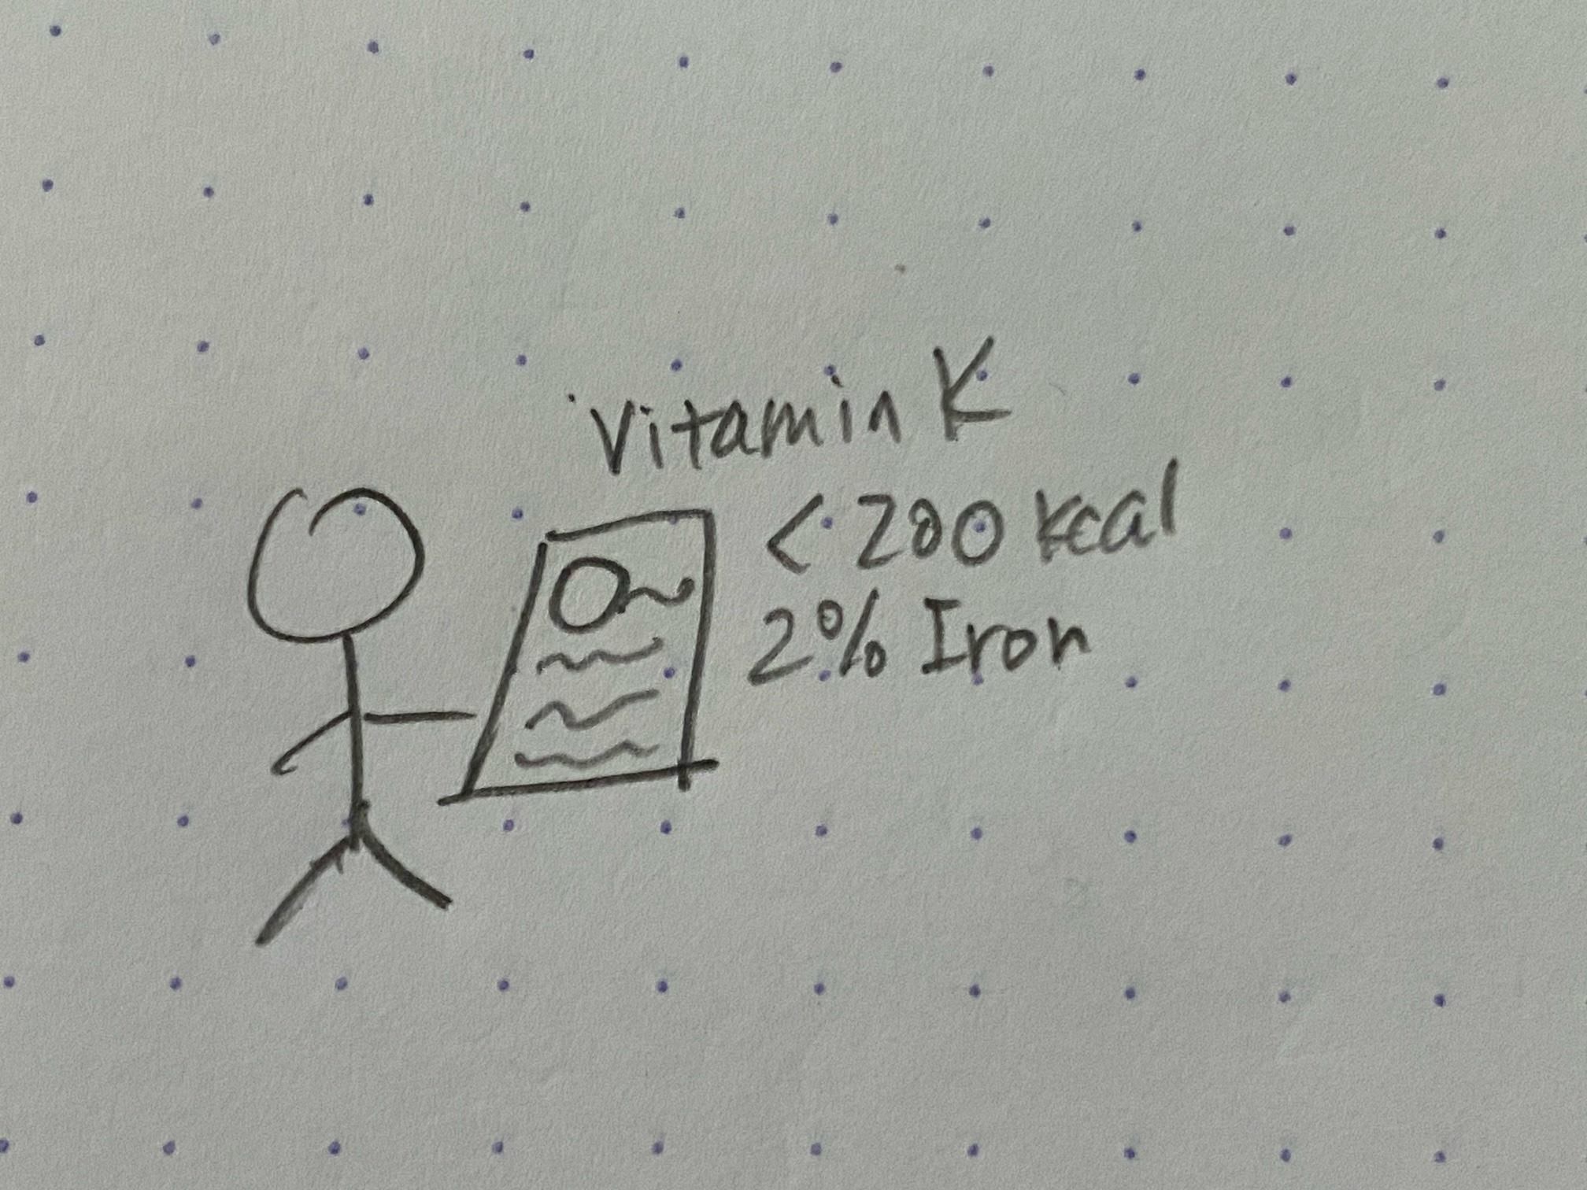
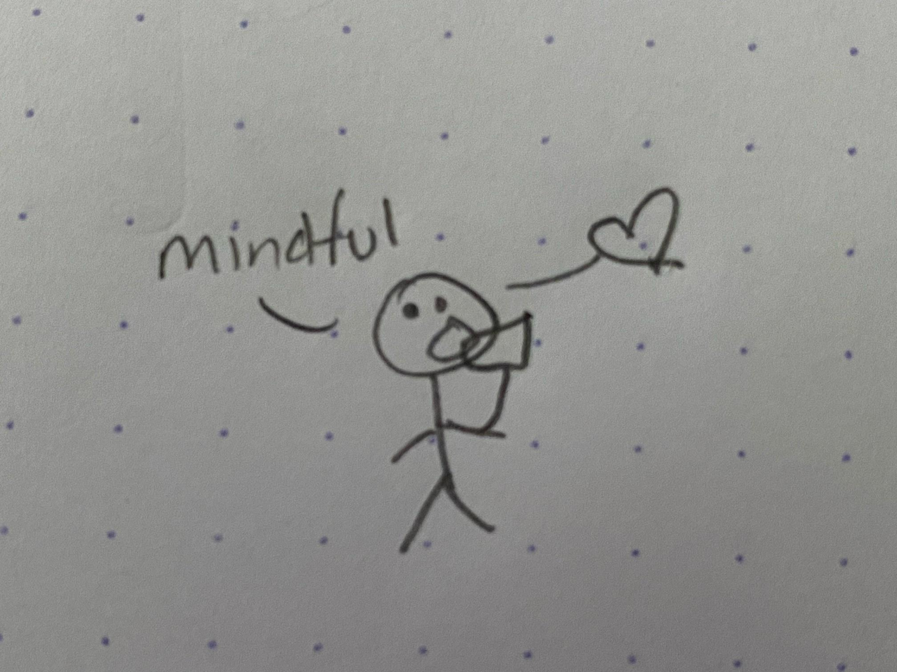
UX Design Storyboard
Scenario: Use theme park nutrition app to mindfully order snacks – big picture
Anika is having fun at the theme park, but is starting to feel hungry.
She goes to the snack shop.
She pulls up her phone/app to see the options that are available.
She sees an item that looks good, and clicks into the details to see the macro and micro nutrients.
She places order through the integrated app.
She eats the snack, and feels happy with her choice since she picked something low in calories and contains lots of vitamins.

